Slide 1
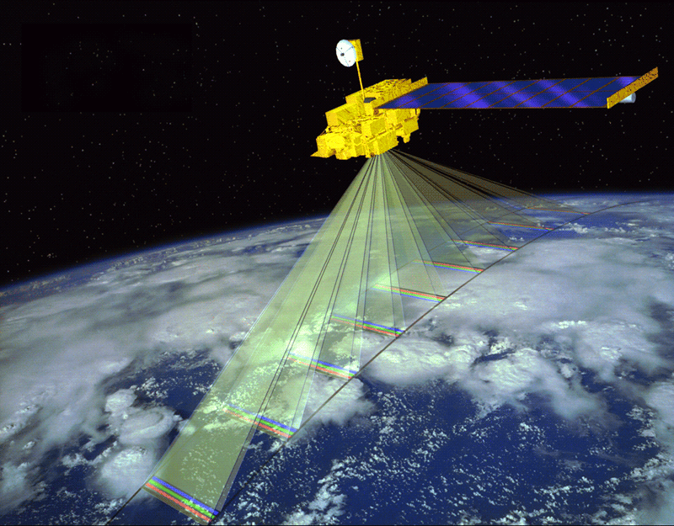
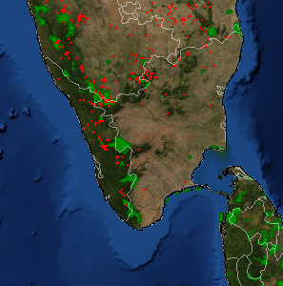
Near - Real Time Forest Fire Detection by
Processing Satellite Spectroradiometer Data
Samiran Roy

Slide 2
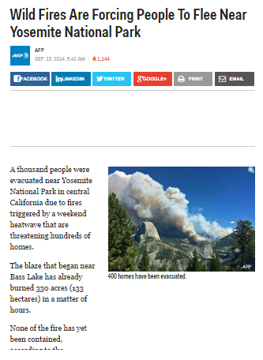
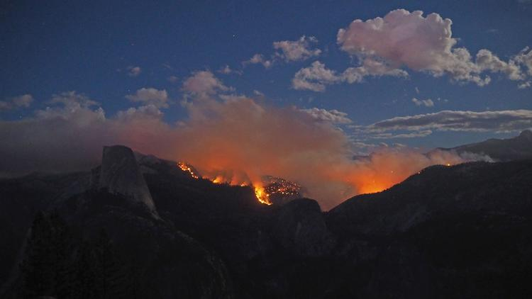
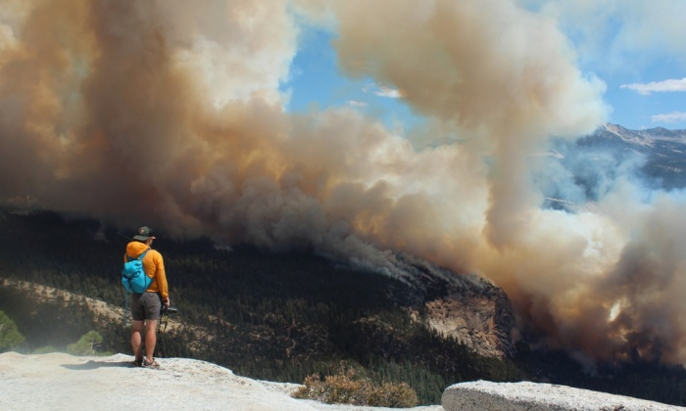
Acres Burned: 4,772
Containment: 80%
Fire Start Date: July 19, 2014
Fire Discovered: 8/15/14
Fire Cause: Lightning
Est. Containment: 9/21/14
Structures Threatened: 0
Structures Damaged: 0
Injuries: 2
Total Personnel: 328
Cost to date: $4.9 million

Slide 3
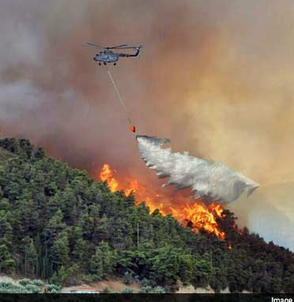
Key Points
Visakhapatnam Fire
What happens when fires get out of control? IAF Bambi Bucket ~ 3500 Litres of Water
Importance of Early Detection

Slide 4
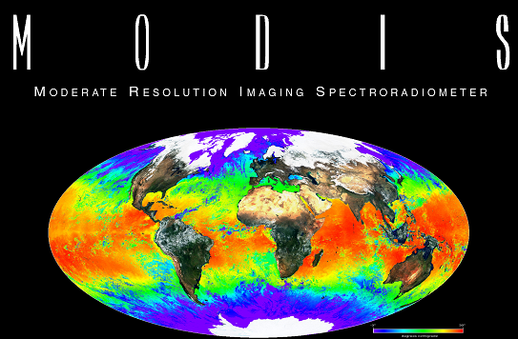
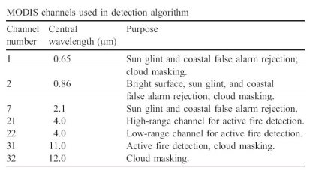
Aqua and Terra Satellites
36 bands of data
Fire observations are made four times a day
Terra AM (10:30 and 22:30) Aqua and PM (13:30 and 01:30)
Notes:
Band 3-6-7 water frozen?
Onboard Terra, MODIS sees the Earth during the morning, while Aqua MODIS orbits the Earth in the afternoon.
fire information for resource management

Slide 5
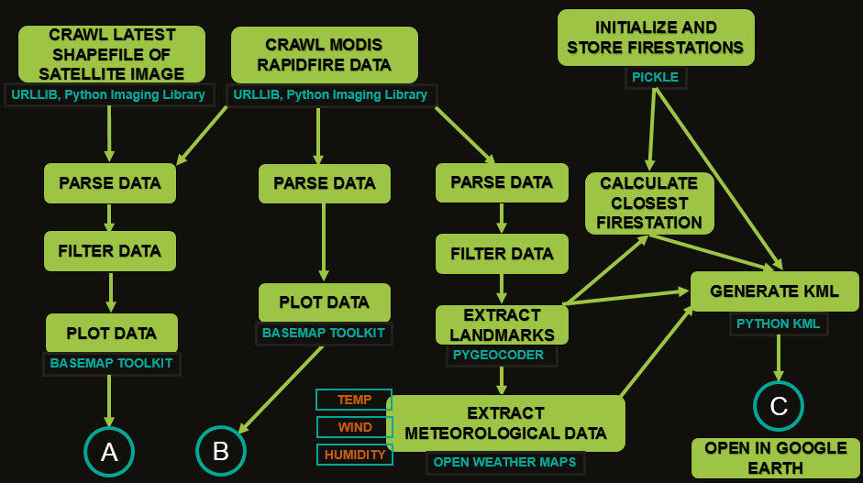

Slide 6
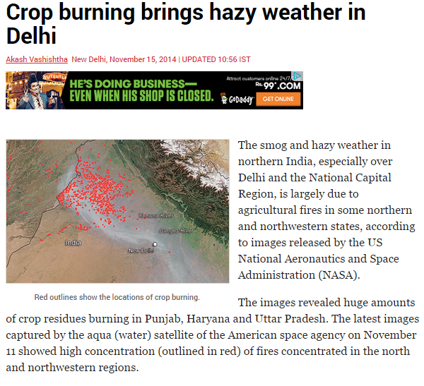
Crop burning is already illegal in most states in India, including Punjab, and violators are supposed to be booked under Section 188 of the Indian Penal Code and the Air (Prevention and Control of Pollution) Act. As with many laws in india, it is ignored.

Slide 7
Conditions for Dangerous Spread
Temperature > 80 F or 26.6 C
Wind Speed >3 mph
Humidity < 55%
Fuel Moisture - 10 to 20% -?

Slide 8
Limitations
No Fuel Moisture Map Available
Indian Remote Sensing Satellite (IRS 1C LISS III)
Accuracy
Not All Forest Fires Detected
Not Enough Data

Slide 9
Thank You

